Slide 1
Databases and Big Data
Lab 1

Slide 2
Today
AWS Basics
MySQL setup
Boto3 (AWS Command Line Interface Wrapper for python)

Slide 3
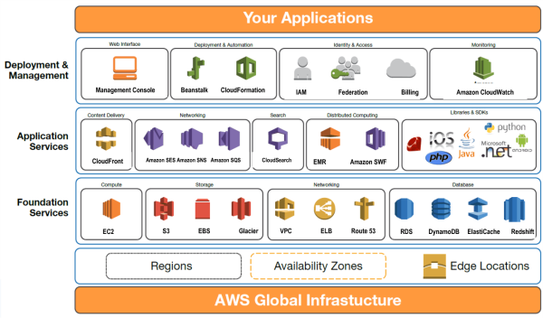
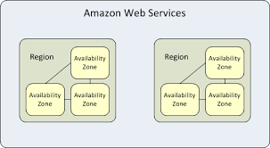
AWS
Most popular
The earliest
Only cover key concepts here
You have $100 to play with
Region
Where servers are
Geographical region, e.g. ap-southeast-1
Multiple availability zones per regions, e.g. ap-southeast-1a

Slide 4
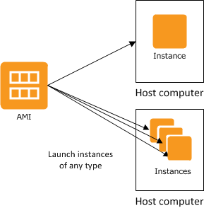
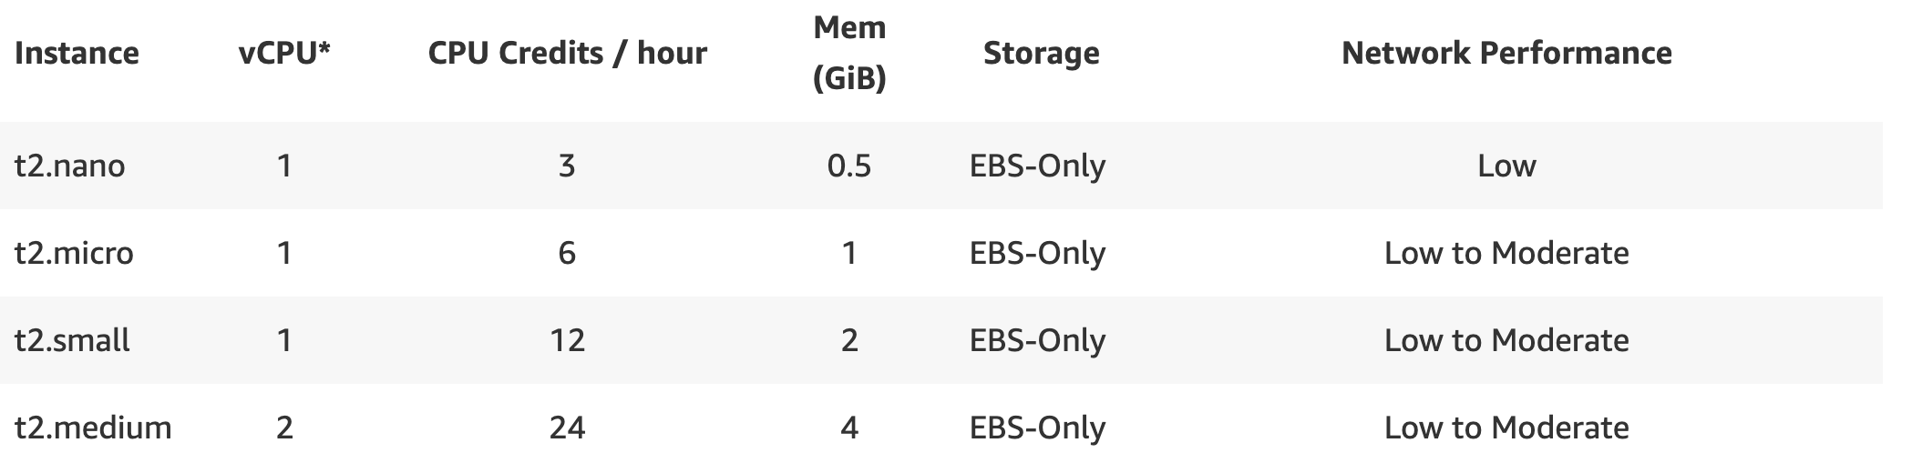
AWS Services
EC2
Amazon Machine Image (AIM): like a virtual machine image
Instance: running image on specific hardware
Like a virtual machine
Instance type: what hardware
Free*

Slide 5
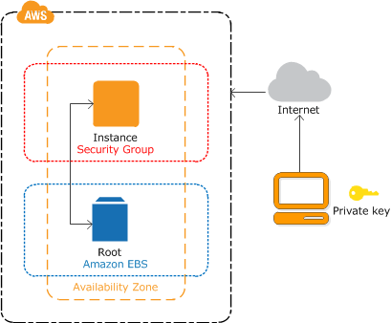
AWS Services
EC2
Elastic Block Storage acts as hard disk.
EC2 Instance and EBS storage should be on same region and same availability zone.

Slide 6

AWS
Security group
Firewall: rules for network access
Each instance belongs to one security group
You can create many groups
Default option: publicly available

Slide 7
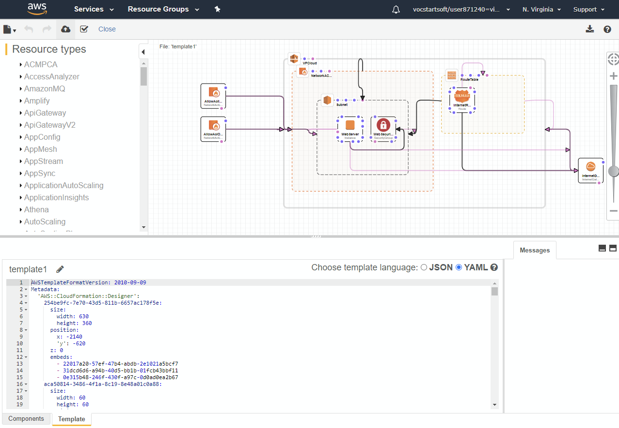
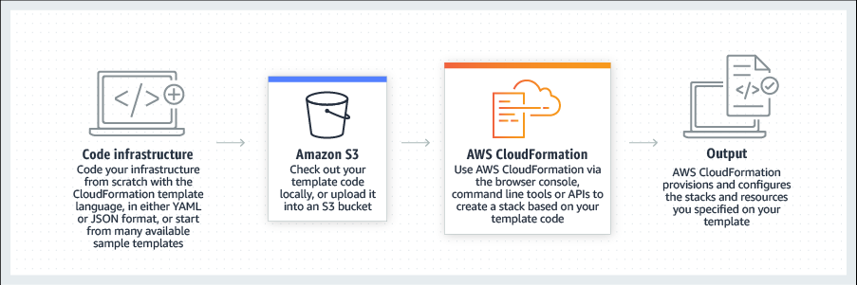
AWS Services
CloudFormation and Designer
Infrastructure as Code
Automate creation of aws resources.

Slide 8
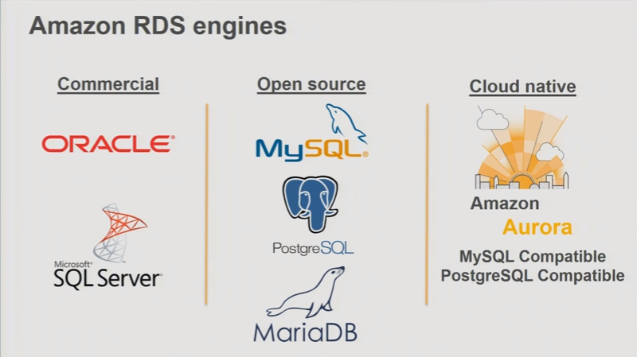
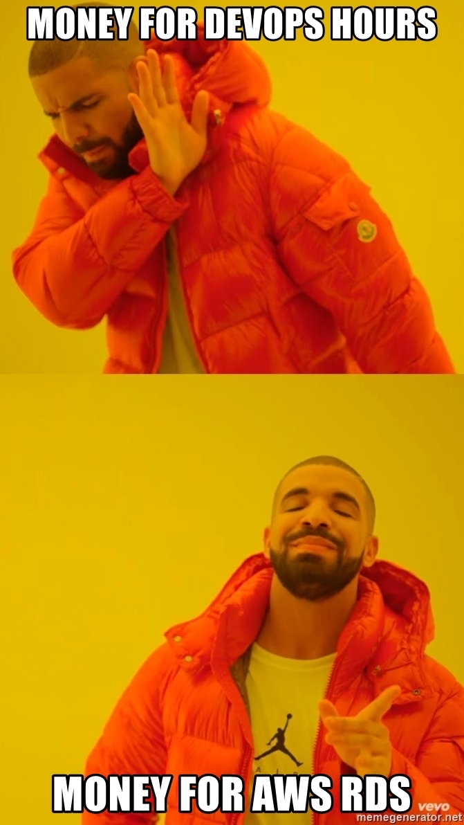
AWS Services
RDS

Slide 9
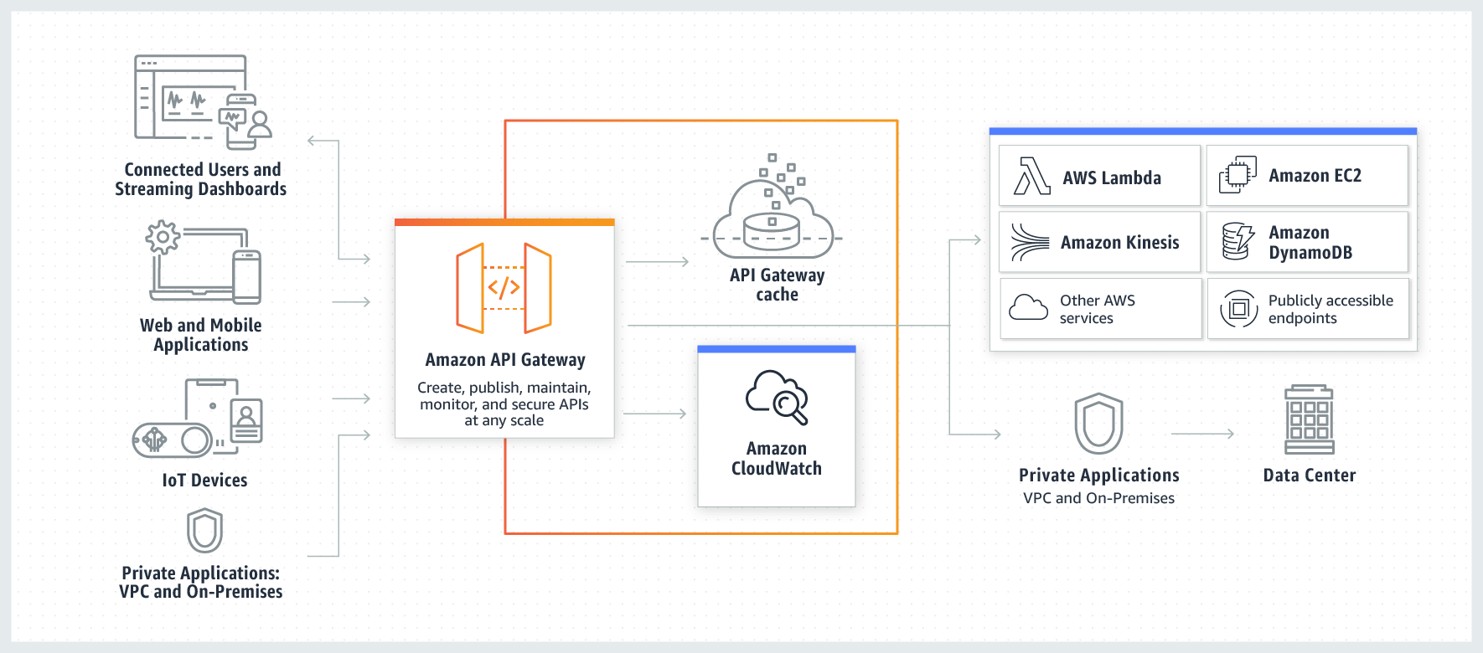
AWS Services
API Gateway

Slide 10
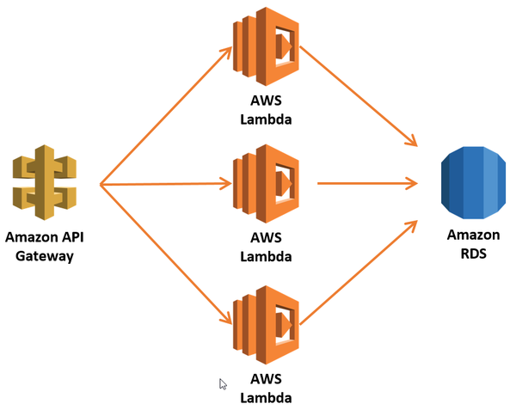
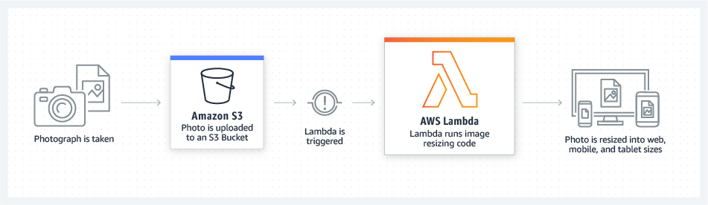
AWS Services
Lambda Functions (Serverless)

Slide 11
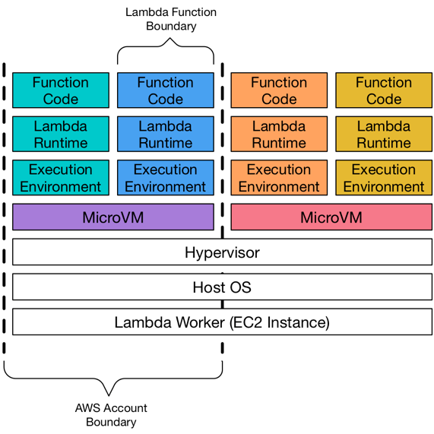
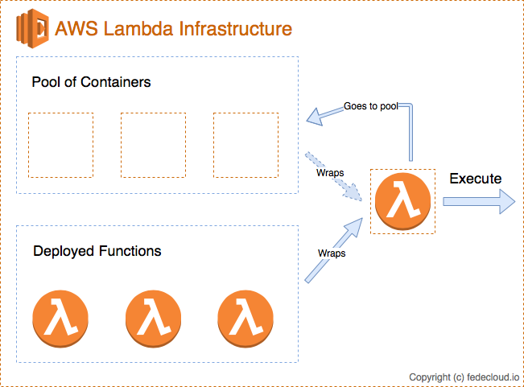
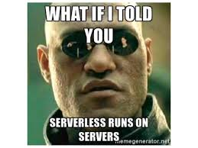
AWS Services
Lambda Functions (Serverless)

Slide 12





AWS
Identity and Access Management (IAM):
Your account has 1 root user (when sign up)
Root user can:
Create IAM users
Grant different IAM user access to different services
Root user
IAM user 1
IAM user 2
IAM user N
Why all these troubles?

Slide 13
AWS
2 types of credentials
Access key:
Short, 40-character string
To invoke AWS APIs, must be kept secret.
SSH key:
Standard SSH key
To log-in to the EC2 instances
Root user
IAM user 1
IAM user 2
IAM user N

Slide 14
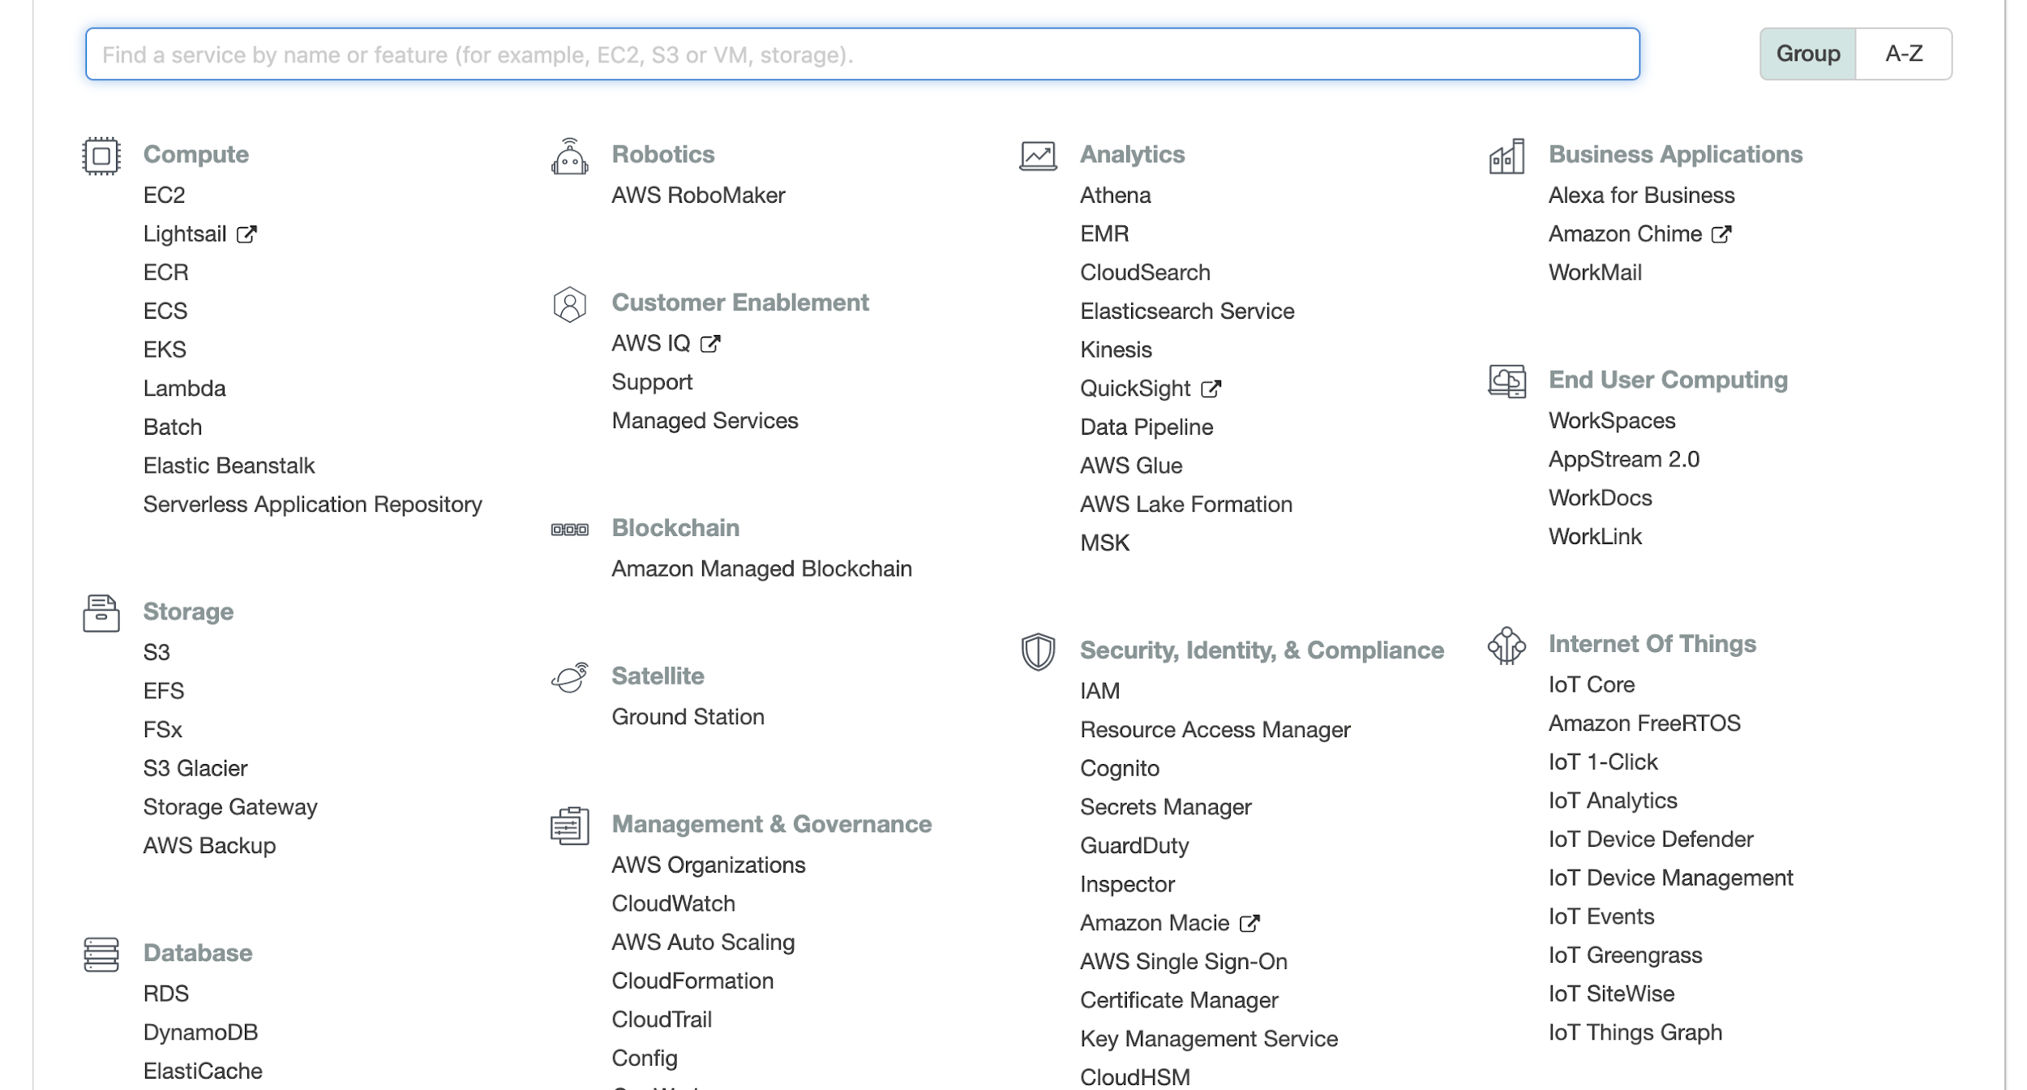
EC2
Access key created via IAM

Slide 15
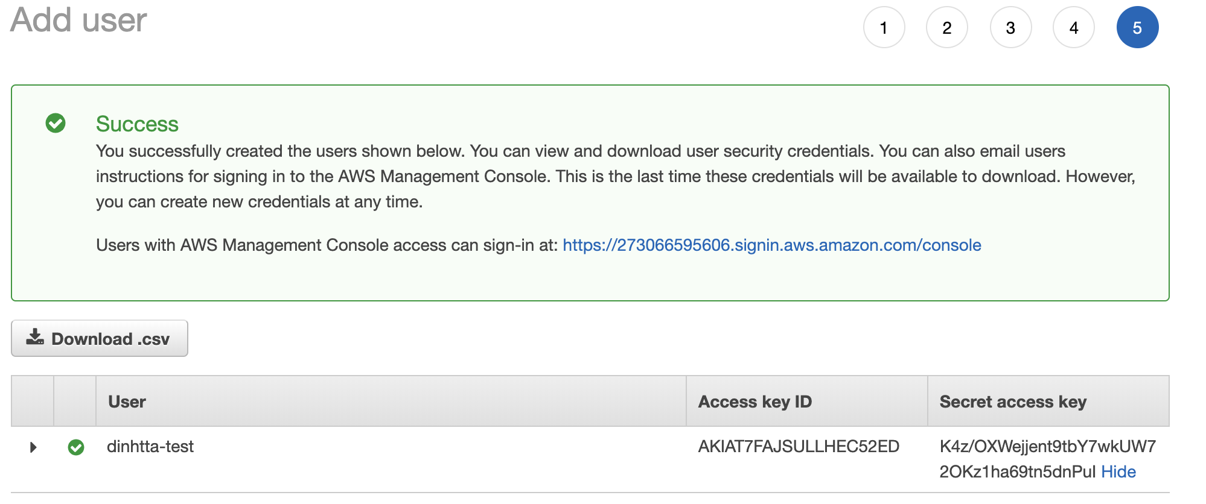
Access Key

Slide 16
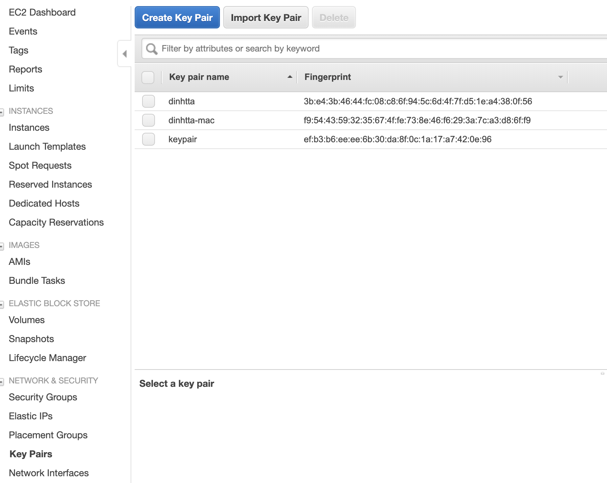
Key Pair
SSH keys
To login to your instances

Slide 17

AWS
How to interact with AWS:
AWS GUI console
Doesn’t scale beyond a handful of instances
This course:
Use command lines
Or boto3 (Python)

Slide 18
AWS EC2 - Creating a EC2 Instance
Log into https://console.aws.amazon.com or https://www.awseducate.com/signin

Slide 19
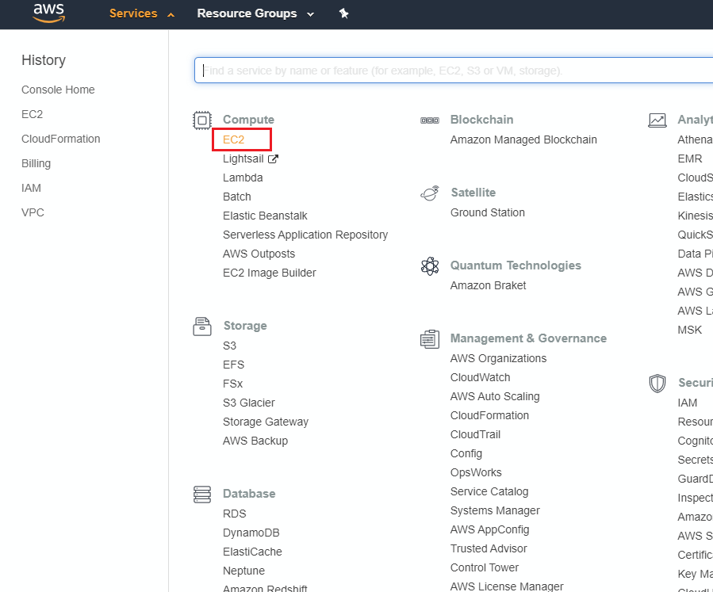
Go to EC2 Service

Slide 20
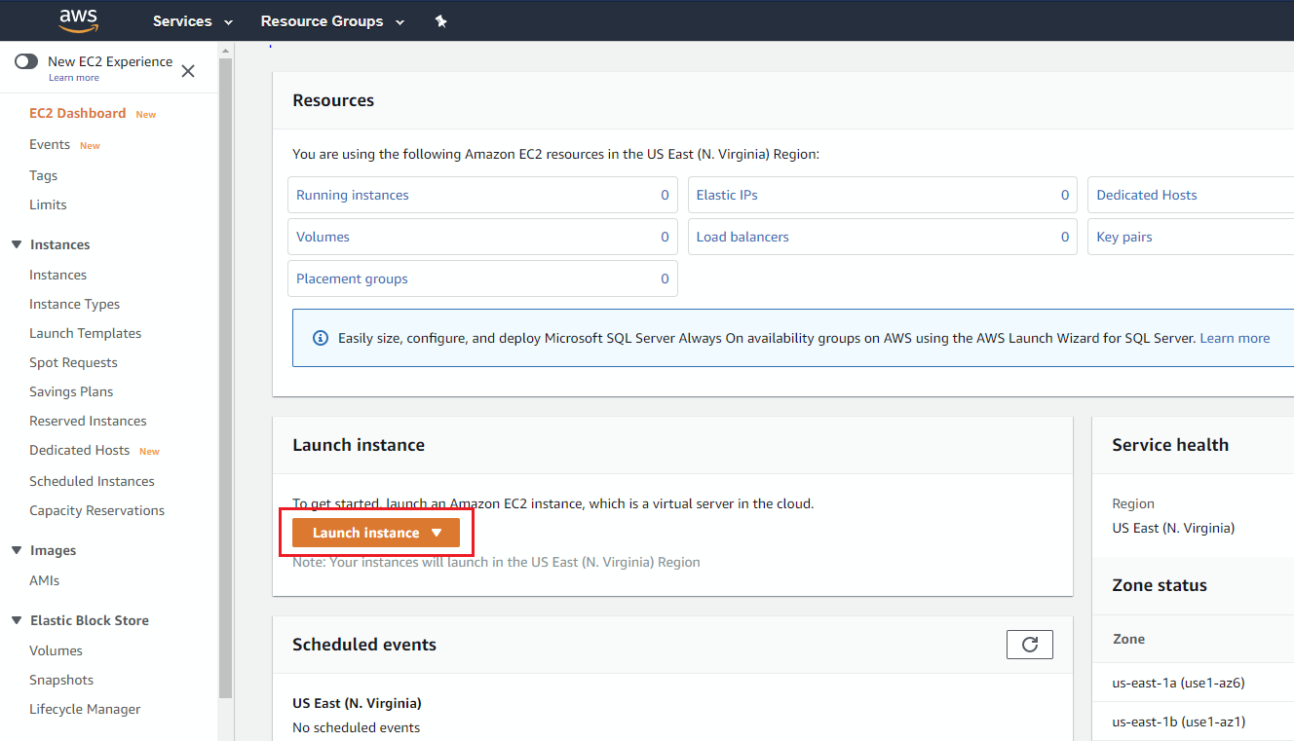
Go to Launch Instance Wizard

Slide 21
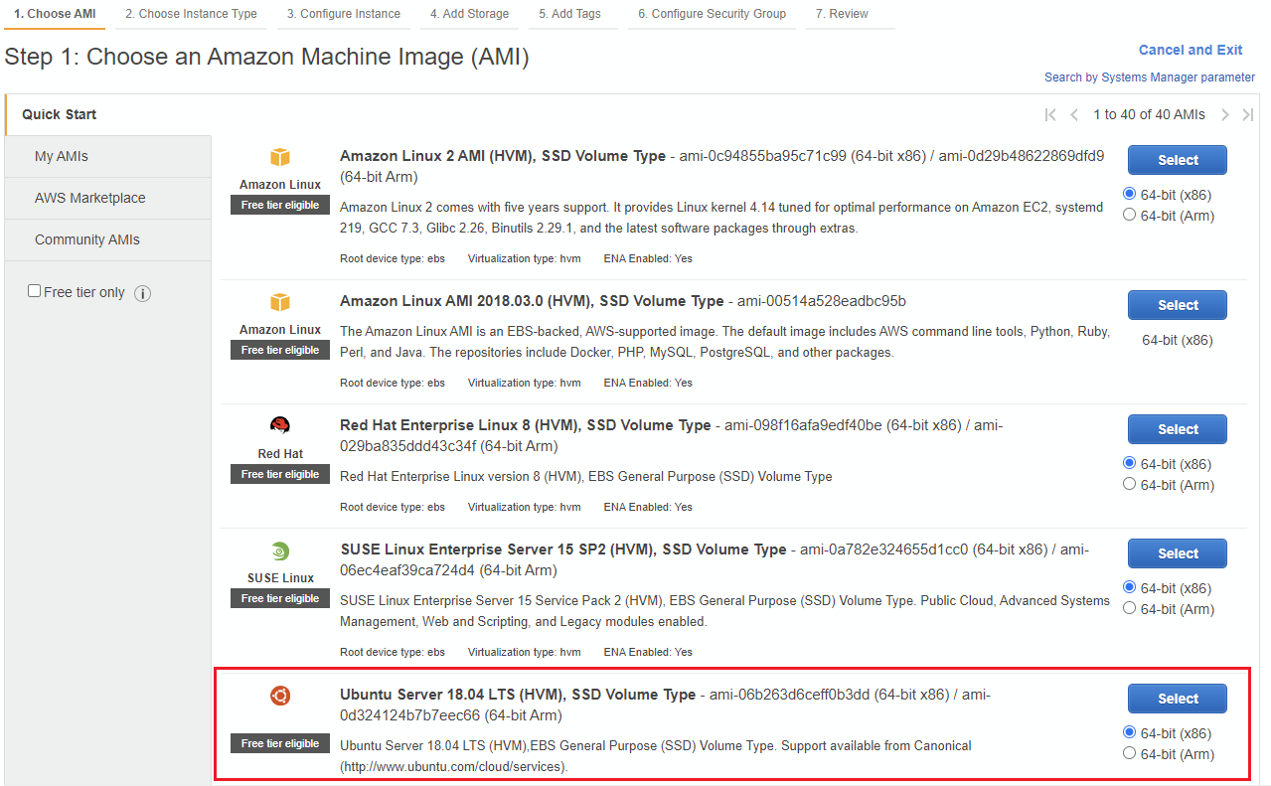
Select an AMI

Slide 22
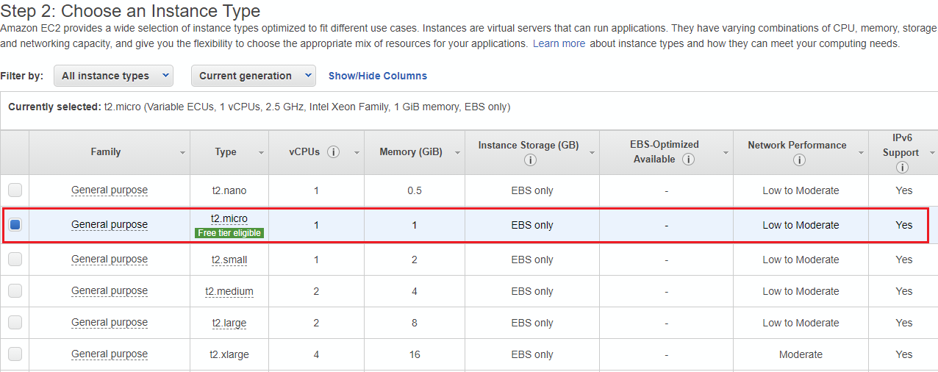
Select an Instance Type

Slide 23
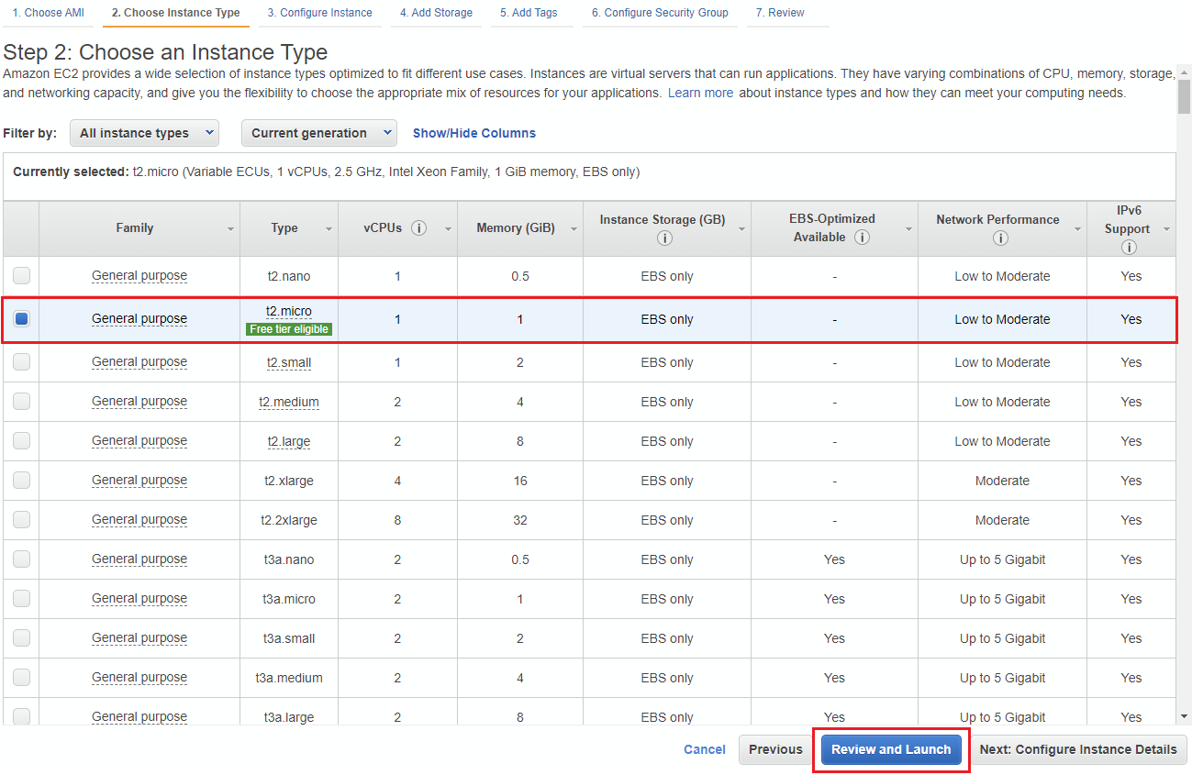
Select an Instance Type and Launch

Slide 24
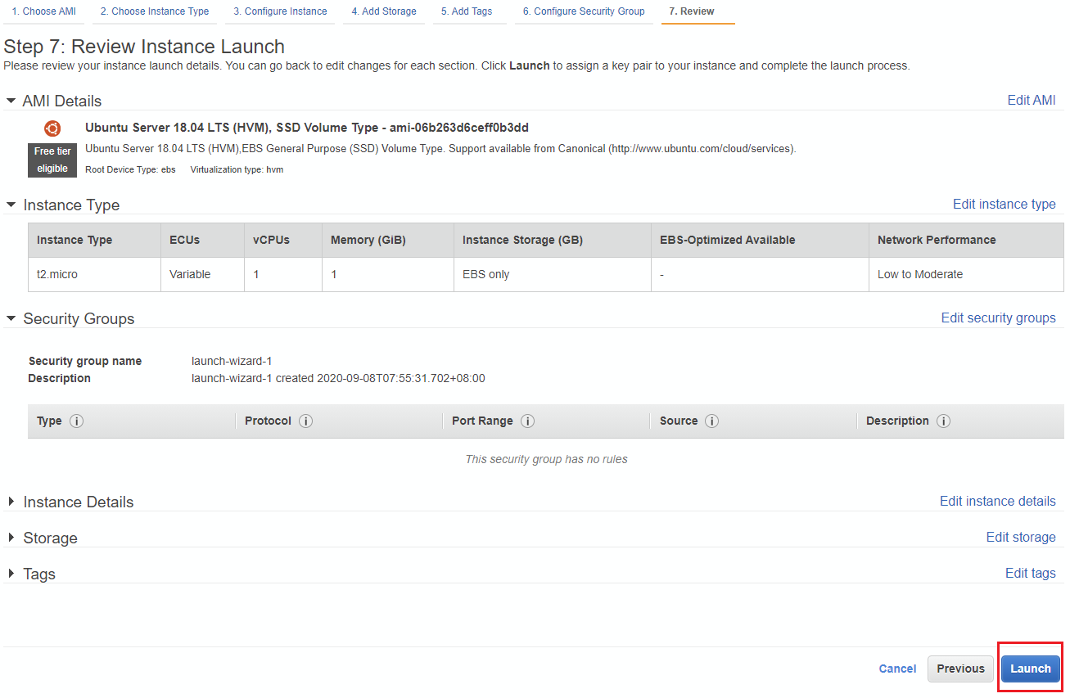
Launch

Slide 25
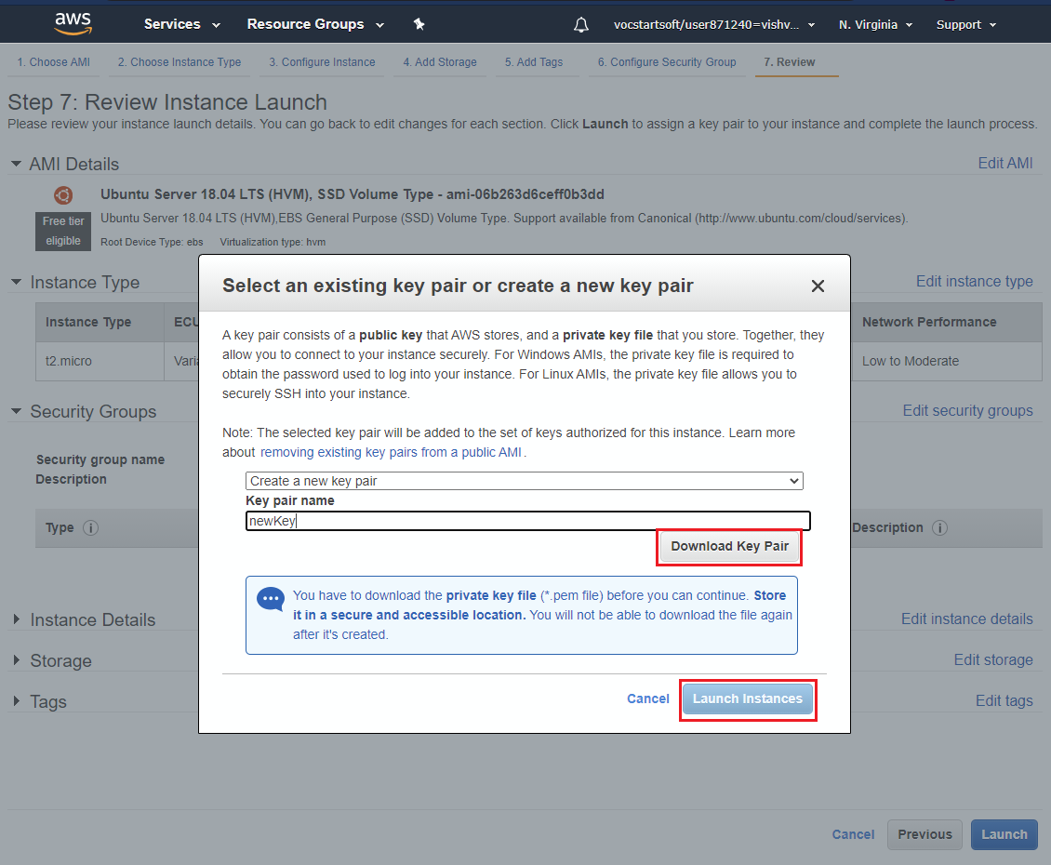
Create Key and Launch

Slide 26
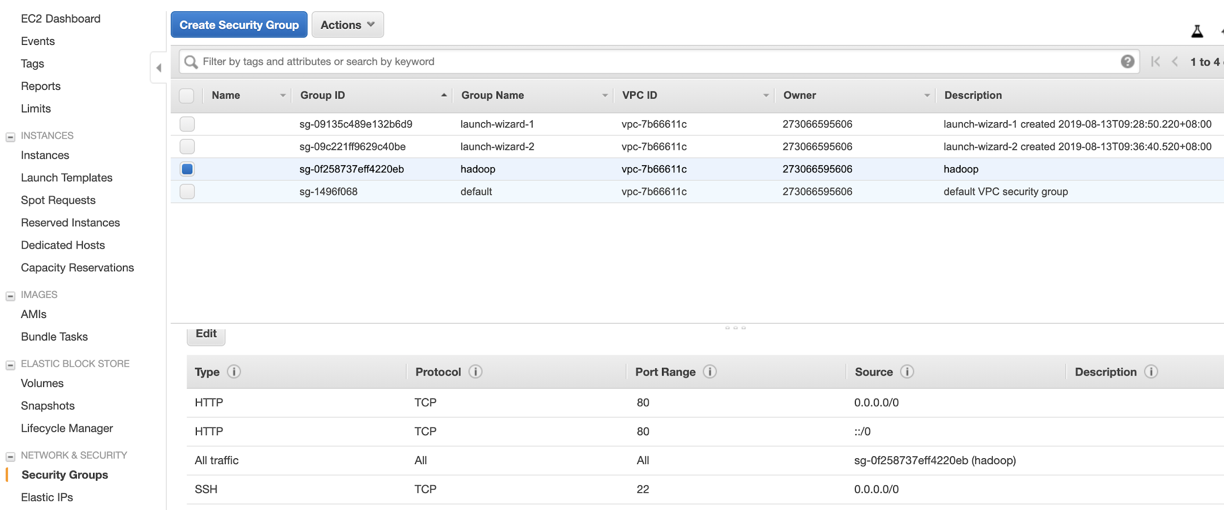
Security Group
Make sure that you allow SSH access

Slide 27
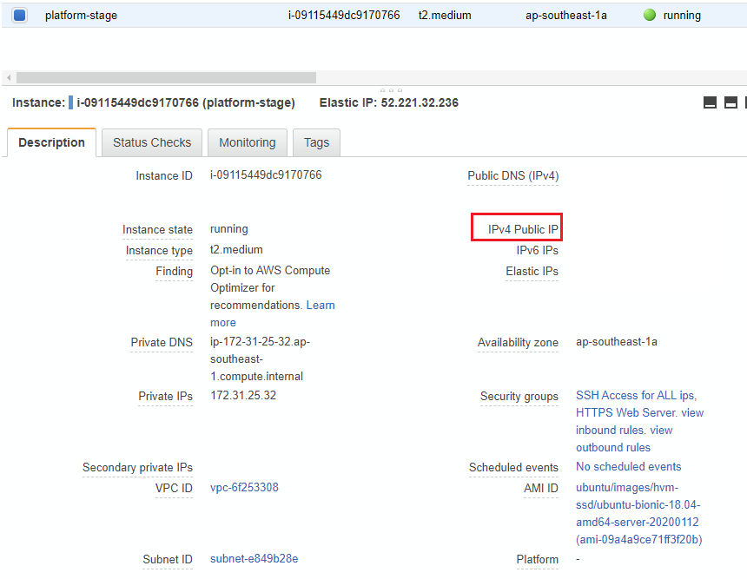
AWS EC2 – Accessing Instance
Locate the public IP of your instance

Slide 28
AWS EC2 – Accessing Instance
Connect using SSH
ssh user@host -i path/to/key.pem
Copy files to server
scp -i path/to/key.pem local/path/file.txt user@host:server/path/file.txt

Slide 29
MySQL Installation
Install mysql-server-5.7 with apt-get
Leave root password blank
mysql -u root
If successful, great!
If not:
Need to explicitly grant access to “root” user
Then restart the server
Now you should see the console
sudo mysql -e 'update mysql.user set plugin = "mysql_native_password" where user="root"' sudo mysql -e 'create user "root"@"%" identified by ""' sudo mysql -e 'grant all privileges on *.* to "root"@"%" with grant option' sudo mysql -e 'flush privileges' sudo service restart

Slide 30
MySQL Hands-on
Show databases
Switch to a database
Configure mysql so it can be accessed remotely.

Slide 31
MySQL remote access config
my.cnf
# The MySQL database server configuration file.
#
# You can copy this to one of:
# - "/etc/mysql/my.cnf" to set global options,
# - "~/.my.cnf" to set user-specific options.
#
# One can use all long options that the program supports.
# Run program with --help to get a list of available options and with
# --print-defaults to see which it would actually understand and use.
#
# For explanations see
# http://dev.mysql.com/doc/mysql/en/server-system-variables.html
#
# * IMPORTANT: Additional settings that can override those from this file!
# The files must end with '.cnf', otherwise they'll be ignored.
#
# mysql config for import access
!includedir /etc/mysql/conf.d/
!includedir /etc/mysql/mysql.conf.d/
[mysqld]
#secure-file-priv=""
#local_infile=1
bind-address = 0.0.0.0

Slide 32

Why not to use default config for mysql
https://www.zdnet.com/article/hackers-are-scanning-for-mysql-servers-to-deploy-gandcrab-ransomware/
Change default port, secure root user, run mysql_secure_installation
Implement granular access for users

Slide 33
MySQL Exercise
Create a flask app with single api CRUD endpoint that connects to mysql db to retrieve data.
Launch it on your pc
Test app API using postman.

Slide 34
MySQL connecting remotely
Install mysql client
sudo apt-get install mysql-client
Connect to server
mysql –u root –p --host=<PublicIP> --port=3306

Slide 35
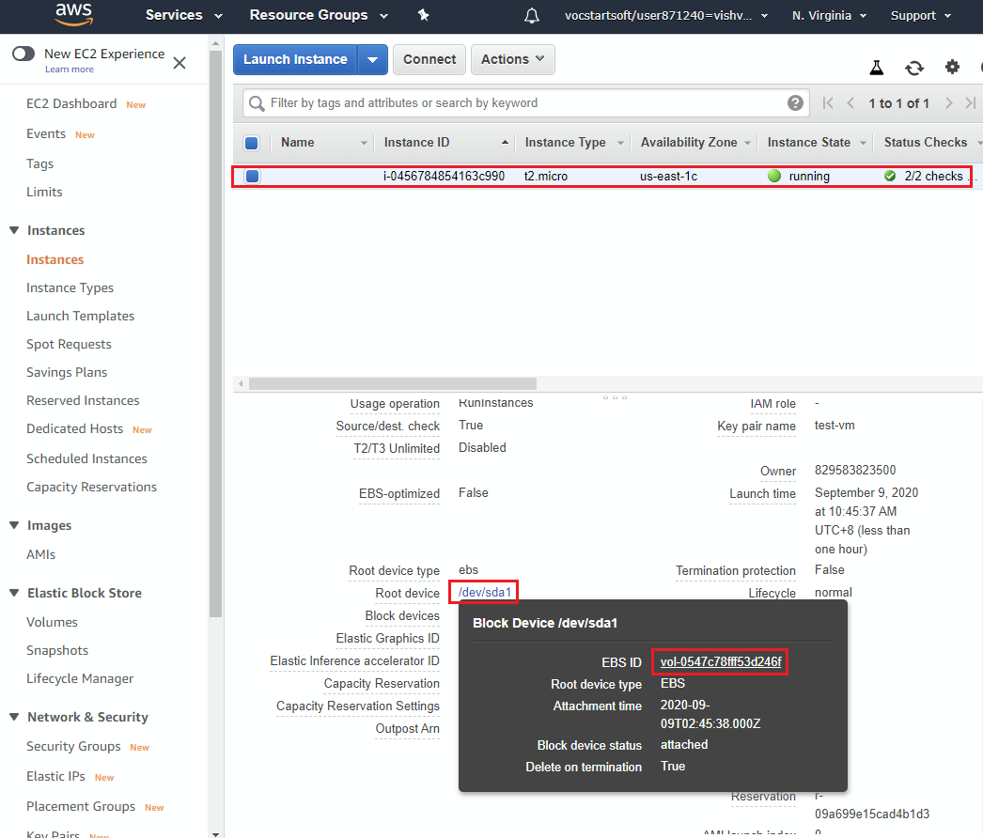
AWS: Creating a Snapshot of MySQL server
Go to EC2 Dashboard and locate VolumeID

Slide 36
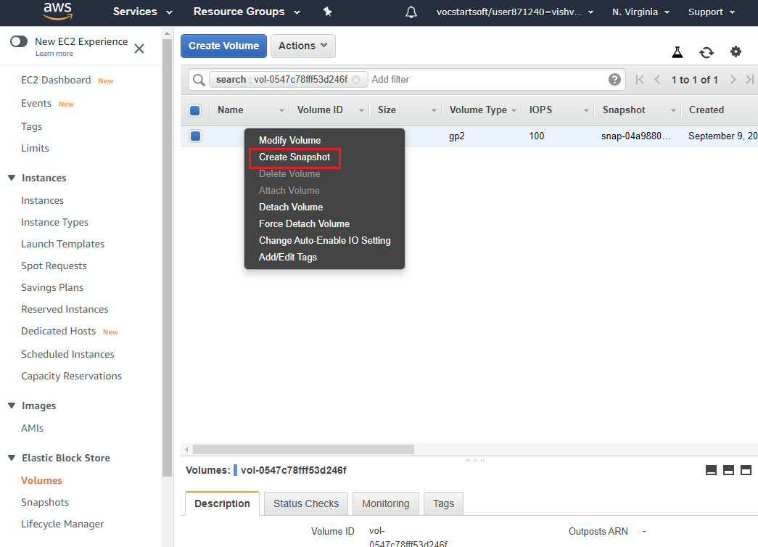
AWS: Creating a Snapshot of MySQL server
Navigate to Volume dashboard and select create Snapshot from context menu.

Slide 37
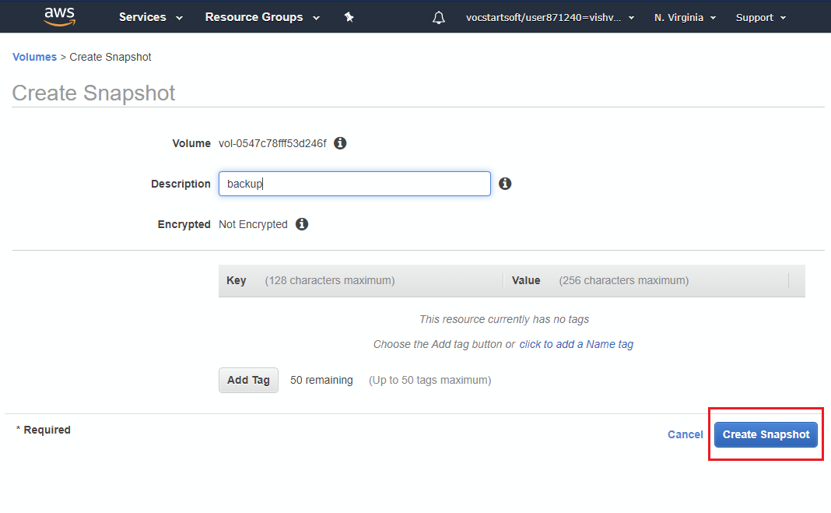
AWS: Creating a Snapshot of MySQL server
Create snapshot

Slide 38
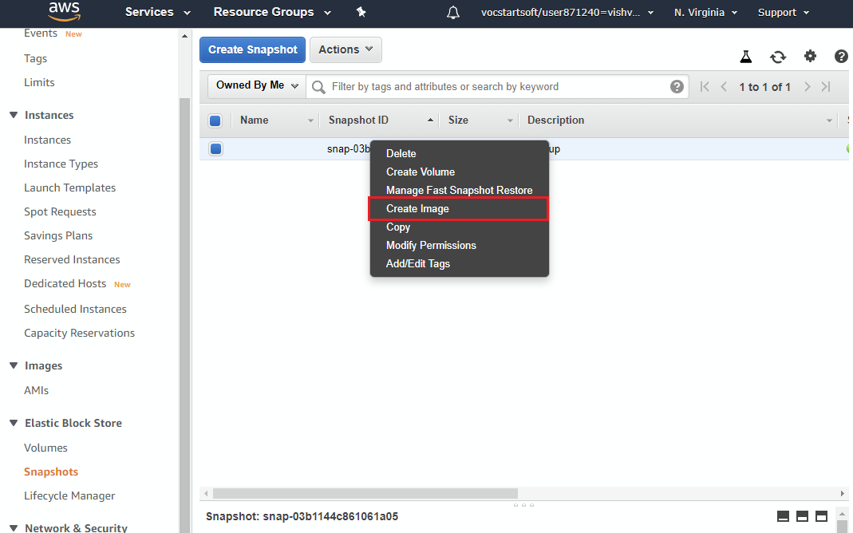
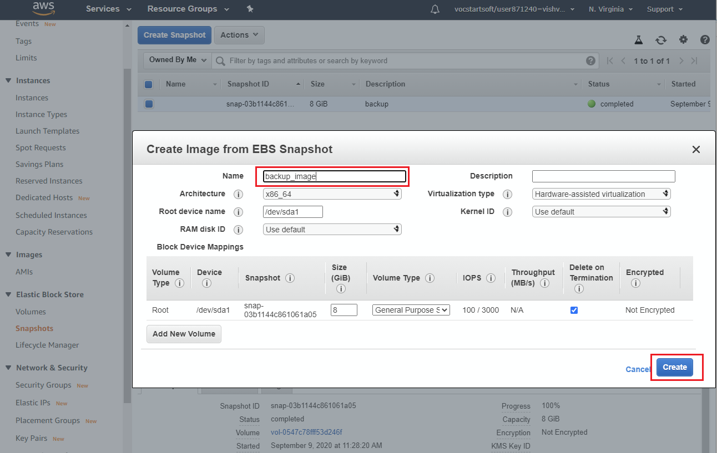
AWS: Launching EC2 using snapshot
Create Image

Slide 39
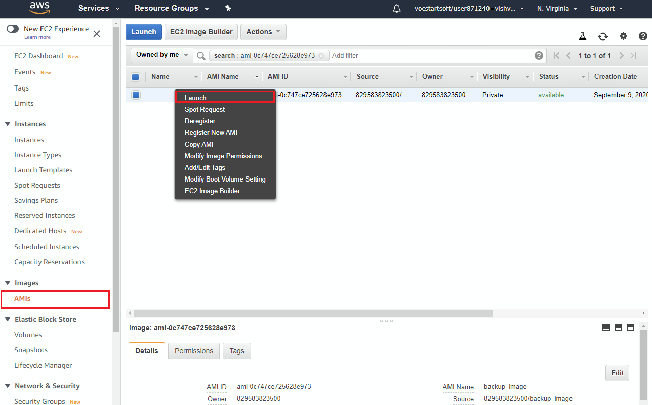
AWS: Launching EC2 using snapshot
Launch Image

Slide 40
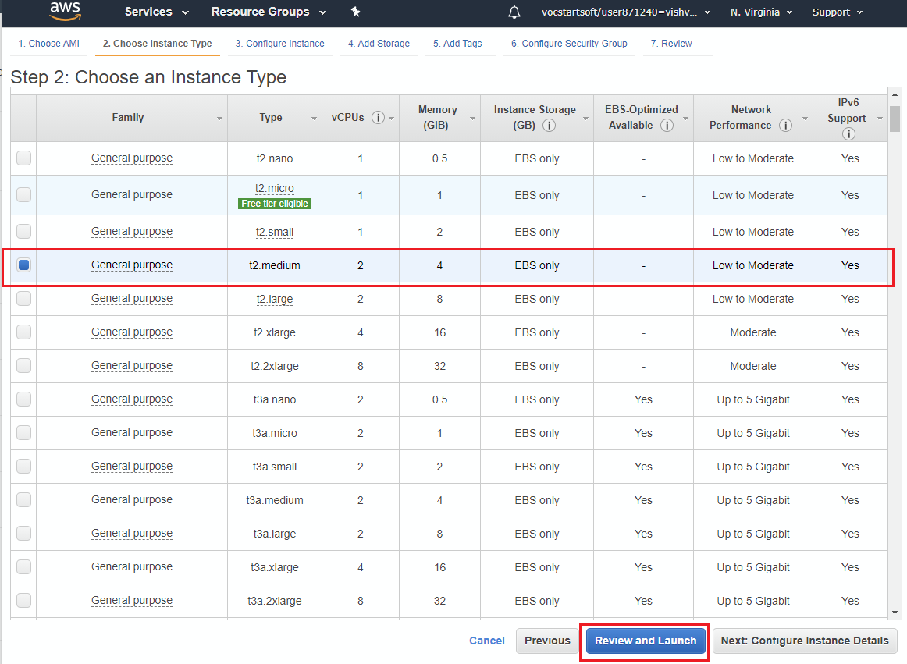
AWS: Launching EC2 using snapshot
Launch a different instance type

Slide 41
Boto3
Python library for accessing AWS services
Your Python application
boto3.client(‘ec2’)
Boto3
boto3.client(‘s3’)
~/.aws

Slide 42

Access key vs. Key pair
Your Python application
boto3.client(‘ec2’)
Boto3
boto3.client(‘ec2’)
Management APIs
~/.aws
Instance
Instance
SSH keys

Slide 43
boto3
Prerequisites
Install aws-cli
https://docs.aws.amazon.com/cli/latest/userguide/install-cliv2-linux.html
Configure aws-cli with access keys
aws configure
Optional – install python pip module if not already installed
sudo apt-get install python3-pip

Slide 44
boto3
Example: start an instance
import boto3
ec2 = boto3.resource('ec2')
# create a new EC2 instance
instances = ec2.create_instances(
ImageId='ami-06b263d6ceff0b3dd',
MinCount=1,
MaxCount=1,
InstanceType='t2.micro',
KeyName='ec2-keypair'
)

